Slide 1
Git + Gerrit Instruction
2017/12/6
Daniel kuo

Slide 2
Outline
What’s Version control
What’s Git
What’s Gerrit
Client Git install & Generate Key
Login Gerrit
Start using Gerrit & Git
Git operation(basic operation)
Git operation(for git gerrit operation)
Connection issue for new Git Tool

Slide 3
What’ version control
Version control software allows us to store different versions of the project at a time. There is a change, just save to next version. If there’s something wrong, we can go back to the previously normal version and compare the differences to find out the code which is causing the problem.
Moreover, there are some situations : If you want to develop new function, we can use version control software to create a branch for a try. If it works, it’s able to merge back to original development of the main line.

Slide 4
What’s Git
Git is exactly version control software. Compared with the subversion (SVN) of centralized version control, Git is decentralized version control. Nearly everything is done on this system. The design of Git is "only add information". Thus, data can be easily restored. Each developer's local host will have a complete program library. It can work independently without restriction of the development of the main line, and network connection.

Slide 5
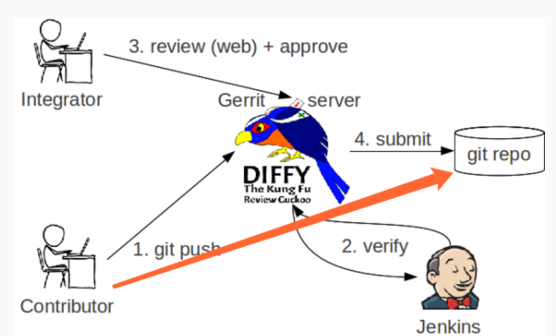
What’s Gerrit
Gerrit is the review software for the open source code using the web interface. By using the web browser, team member can review each other's revised code, and decide whether to submit, return or modify again.

Slide 6
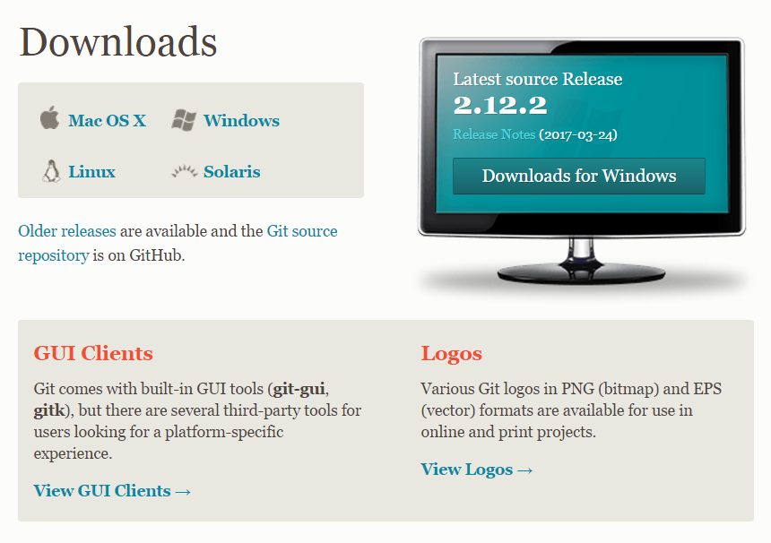
Client Git install
Download git for window https://git-scm.com/downloads

Slide 7
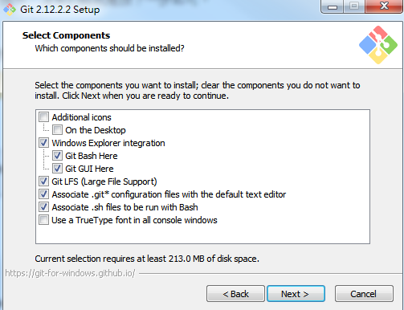
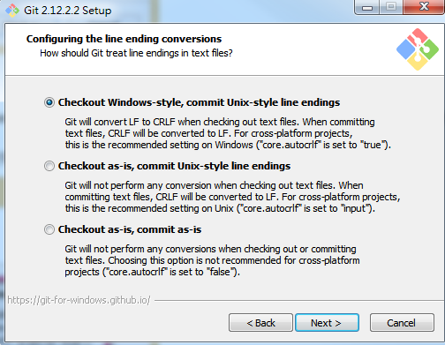
Client Git install

Slide 8
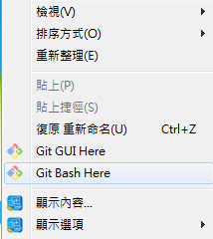
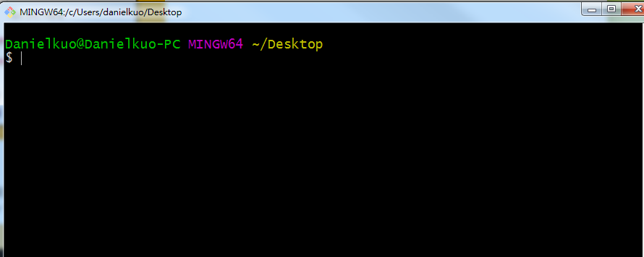
Generate key
Generate key
Command line

Slide 9
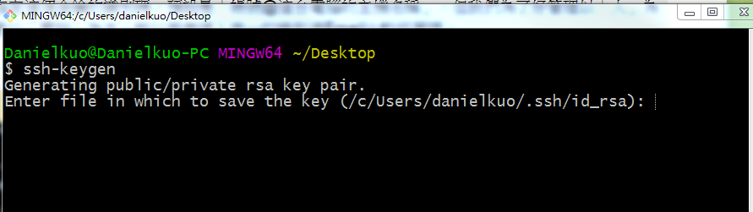
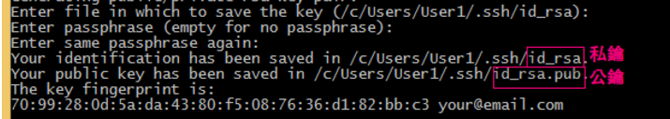
Generate key
Enter ssh-keygen
There will be several options: Generate the path, whether the key to the password, choose to generate a private key and public key

Slide 10
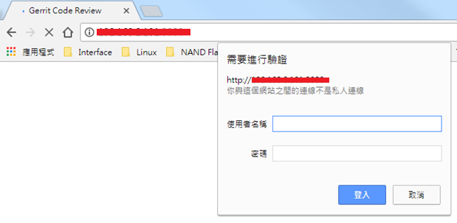
Login Gerrit
Enter user name & password
Login IP:192.168.2.112:8080

Slide 11
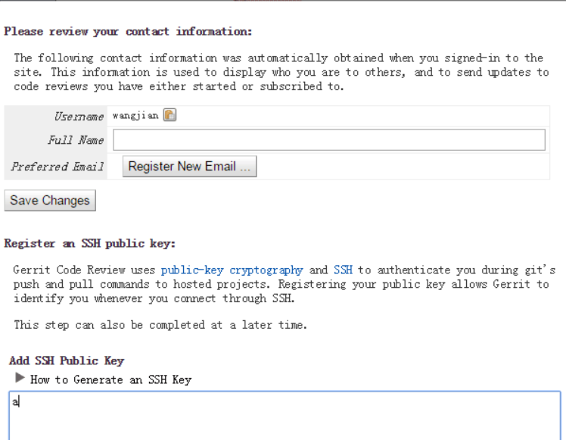
Start using Gerrit & Git
Enter Full name & Register New Email & SSH Key

Slide 12
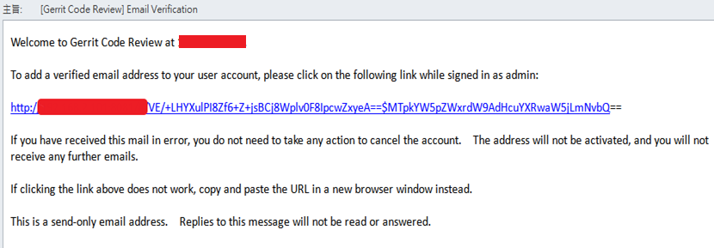
Start using Gerrit & Git
Email Verification

Slide 13
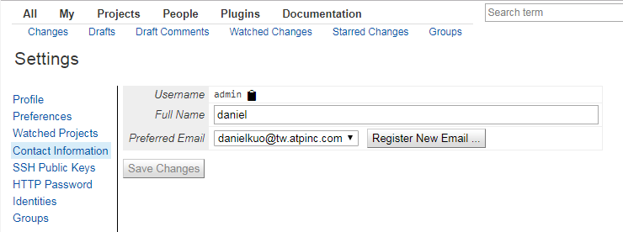
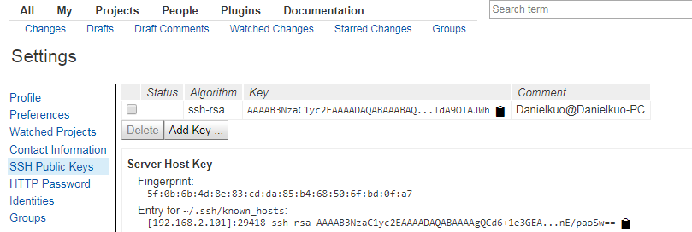
Start using Gerrit & Git
Check Email is not empty & SSH key

Slide 14
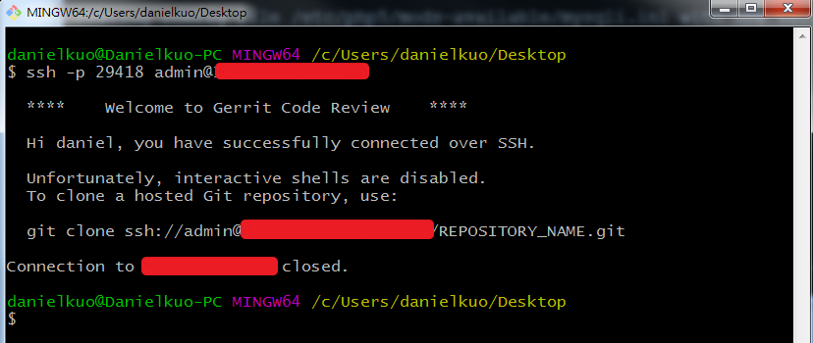
Start using Gerrit & Git
Test SSH connect

Slide 15
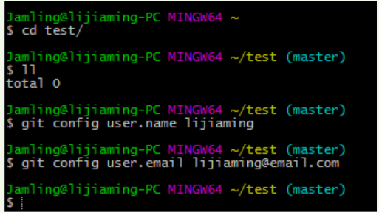
Start using Gerrit & Git
Setting Git config
git config --global user.name“username”
git config --global user.email “your email address”

Slide 16
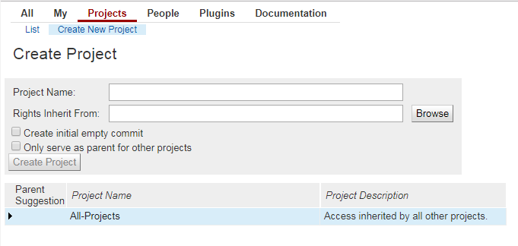
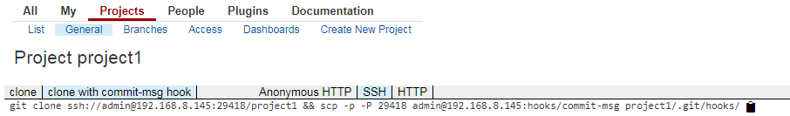
Start using Gerrit & Git
Gerrit create project & select project
Create project
Select project and copy“clone with commit-msg hook” and “SSH”

Slide 17
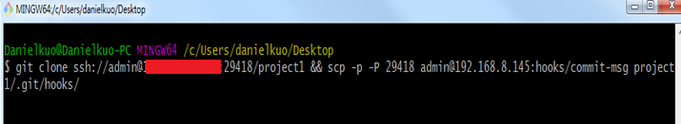

Start using Gerrit & Git
Enter in git bash
You will see the project1

Slide 18
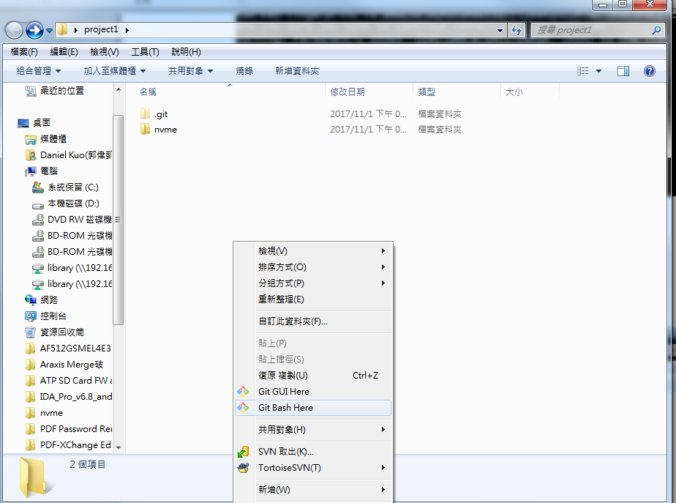
Start using Gerrit & Git
Copy source code to project1
git add . (add new file to git version control)

Slide 19
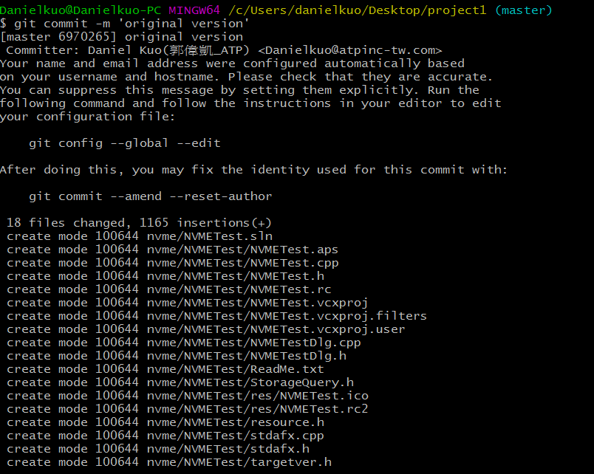
Start using Gerrit & Git
git commit –m ‘message’

Slide 20
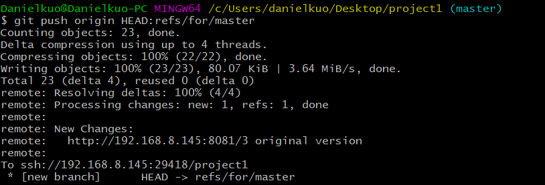
Start using Gerrit & Git
git push origin HEAD:refs/for/master

Slide 21
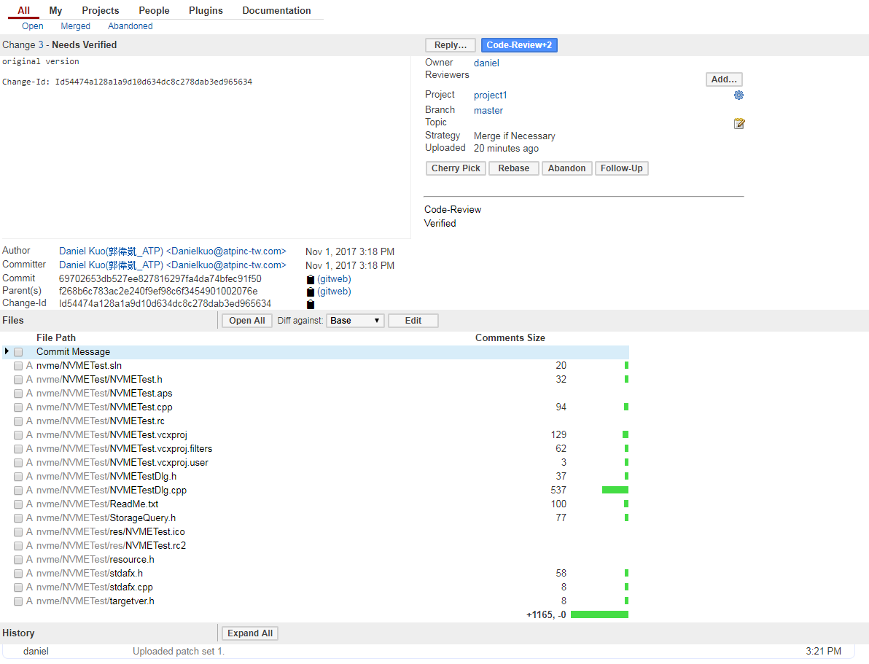
Start using Gerrit & Git

Slide 22
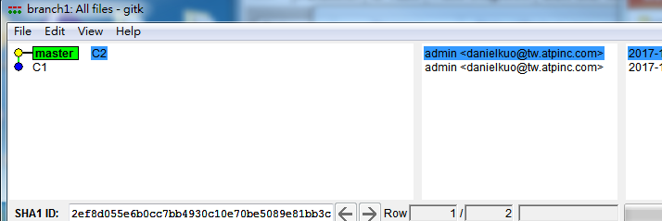
Git operation(basic operation)
Create environment
mkdir branch1
Cd branch1
git init
echo 1 > file1.txt
echo 1 > file2.txt
git add file1.txt
git commit -m "C1"
git add file2.txt
git commit -m "C2"

Slide 23
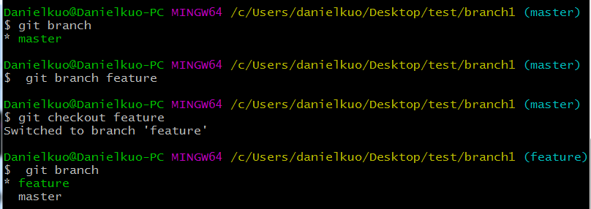
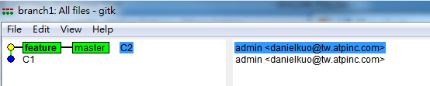
Git operation(basic operation)
git branch(check the current branch)
Create branch and switch new branch

Slide 24
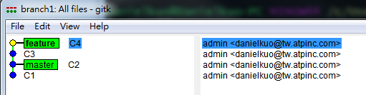
Git operation(basic operation)
Different branch operation
In the feature branch to build a file3.txt file, and submit(commit)
echo 1 > file3.txt
git add .
git commit -m "C3“
Then in the feature branch build file4.txt file,and submit(commit)
echo 1 > file4.txt
git add .
git commit -m "C4"

Slide 25
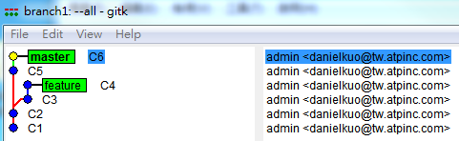
Git operation(basic operation)
Change the branch to do things, first switch to the master branch, and then create file5.txt and file6.txt, and were submitted C5, C6 two versions
git checkout master
echo 1 > file5.txt
git add .
git commit -m "C5"
echo 1 > file6.txt
git add .
git commit -m "C6"

Slide 26
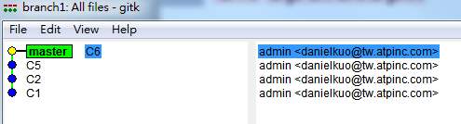
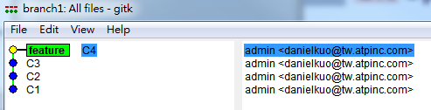
Git operation(basic operation)
Master branch Feature branch
Master
C1
C2
C5
C6
Feature
C3
C4

Slide 27
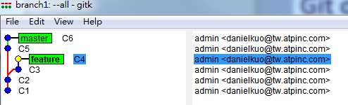
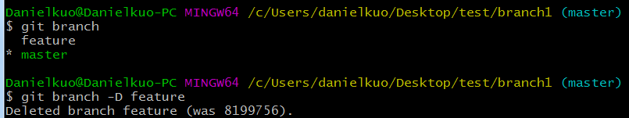
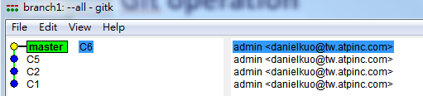
Git operation(basic operation)
Branch remove
Current state and Confirm on which branch
git branch –D feature
Confirm feature branch is still there?

Slide 28
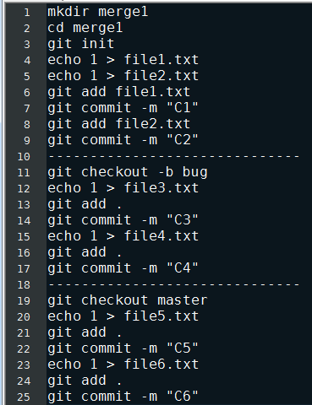
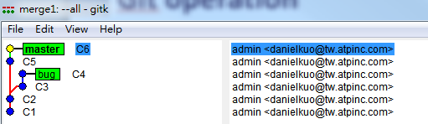
Git operation(basic operation)
Create environment

Slide 29
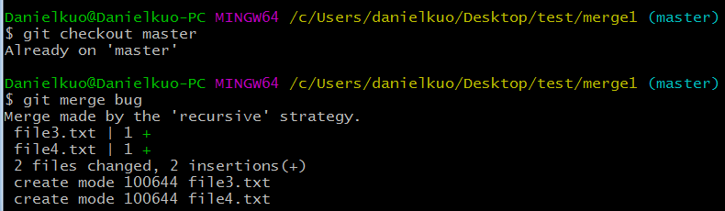
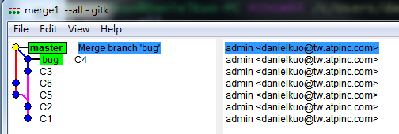
Git operation(basic operation)
Merge the bug branch into the master branch
git checkout master(check state)
git merge bug

Slide 30
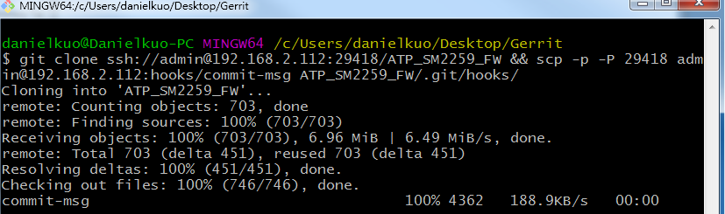
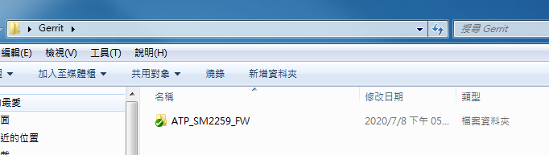
Git operation(for git gerrit operation)
Download folder

Slide 31
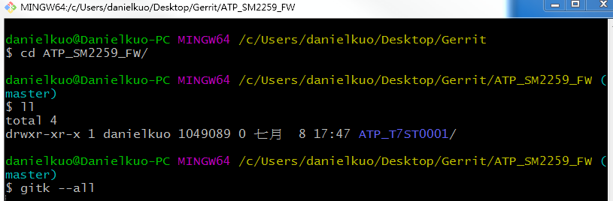
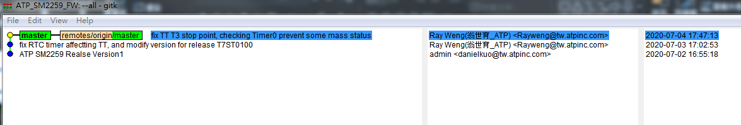
Git operation(for git gerrit operation)
Switch to master branch and check location

Slide 32
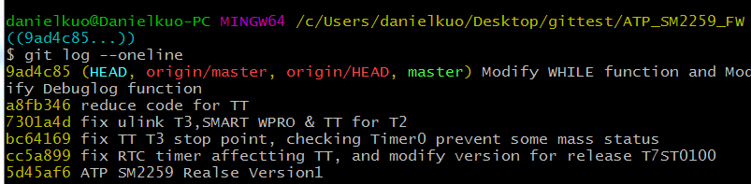
Git operation(for git gerrit operation)
Show all Node

Slide 33
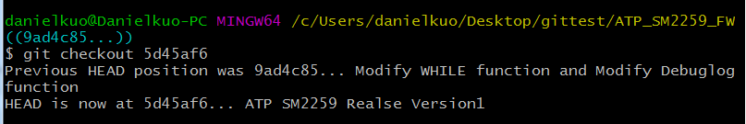
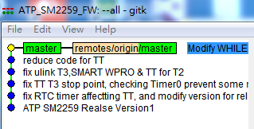
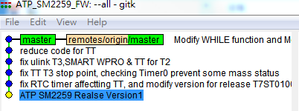
Git operation(for git gerrit operation)
Switch Node to “ATP SM2259 Release Version”

Slide 34
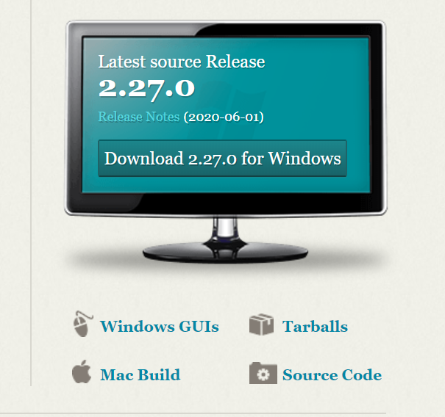
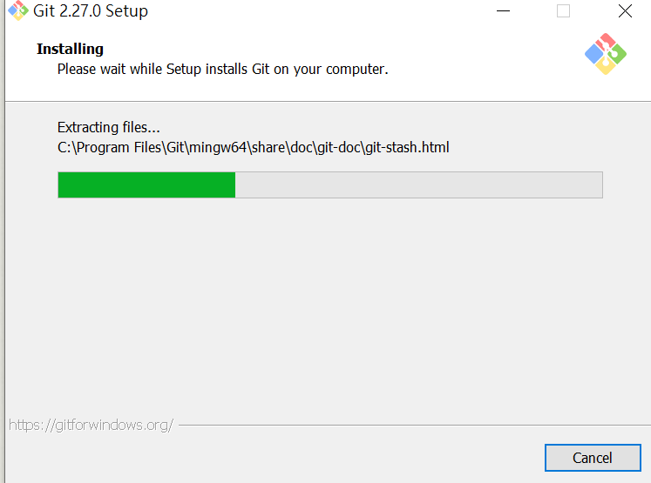
Connection issue for new Git Tool
Step1 download Git Tool and install Git tool

Slide 35
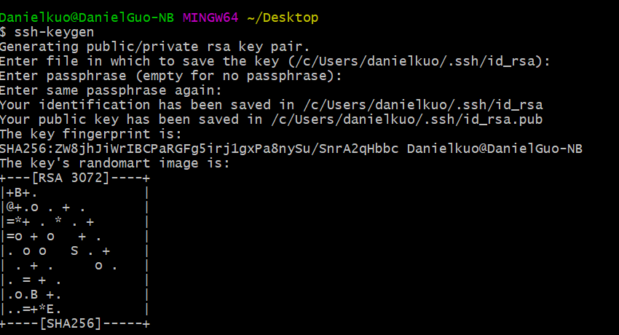
Connection issue for new Git Tool
Step2 Generate SSH Key

Slide 36
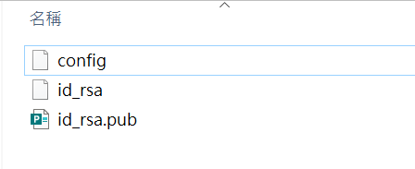

Connection issue for new Git Tool
Step3 Create a new config file in the .ssh folder and add the code

Slide 37
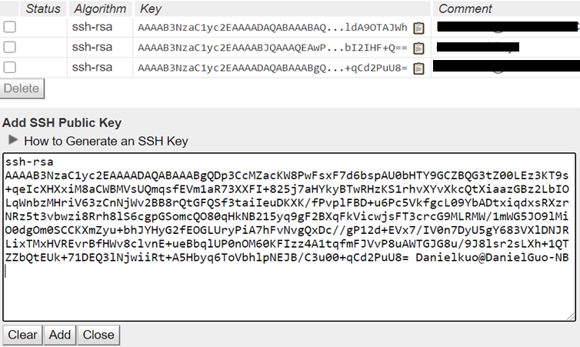
Connection issue for new Git Tool
Step4 add key to gerrit git

Slide 38
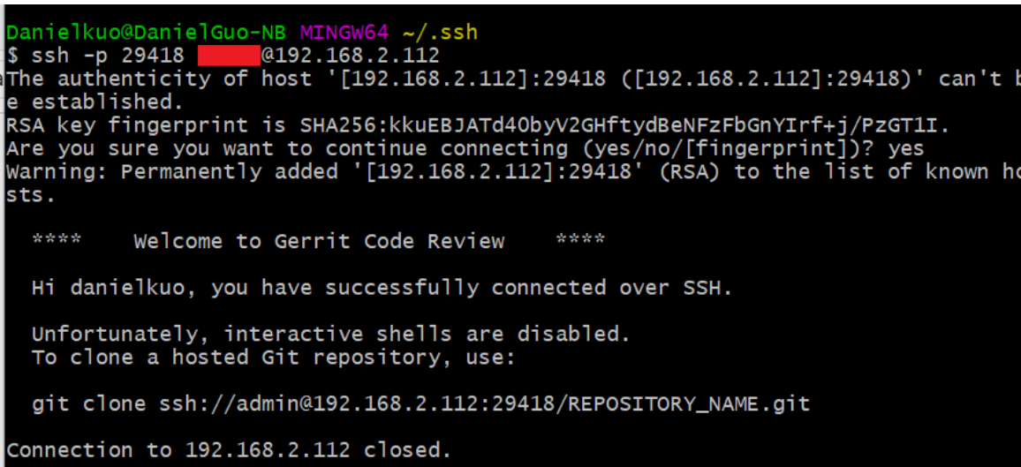
Connection issue for new Git Tool
Step5 Test SSH connect

Slide 39
Thank you

